Slide 1


Boba Bomb
Matthew Yim

Slide 2

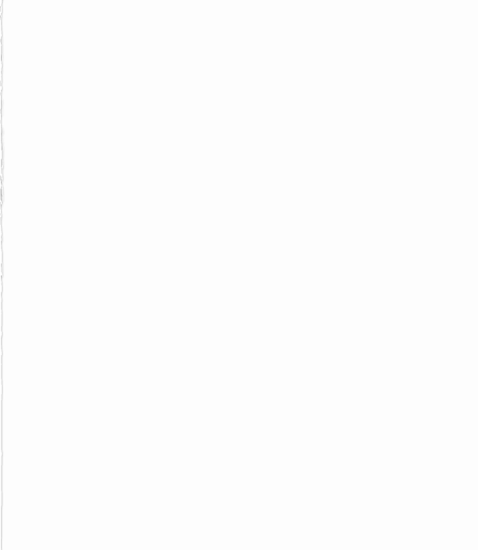
Details about myself
Undergraduate at the University of Minnesota
Pursuing Computer Science / Mechanical Engineering
Previously a Utility/Lead at a glass manufacturing facility
Enjoyed the flexibility and power you have with coding. Limitless possibilities.

Slide 3
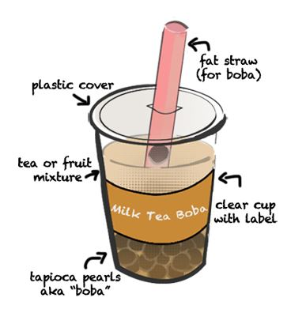
Brief Overview
I wanted to create an ecommerce site so that I could better visual my idea of opening a business
I like bubble tea. And boba goes inside bubble tea. Thus, Boba became a central theme.
Boba are tapioca pearls that are within bubble tea. A tea-based drink that originated in Taiwan

Slide 4
Live Demo

Slide 5
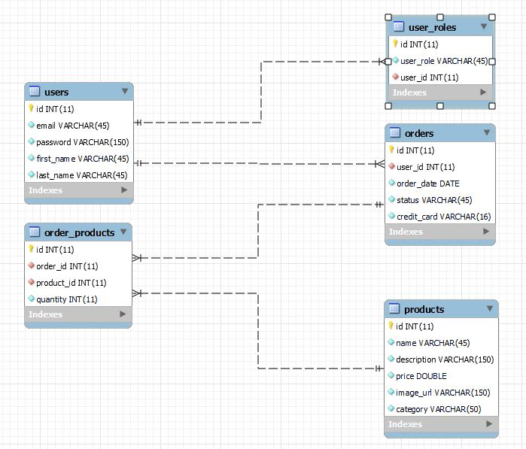
Entity–relationship model

Slide 6
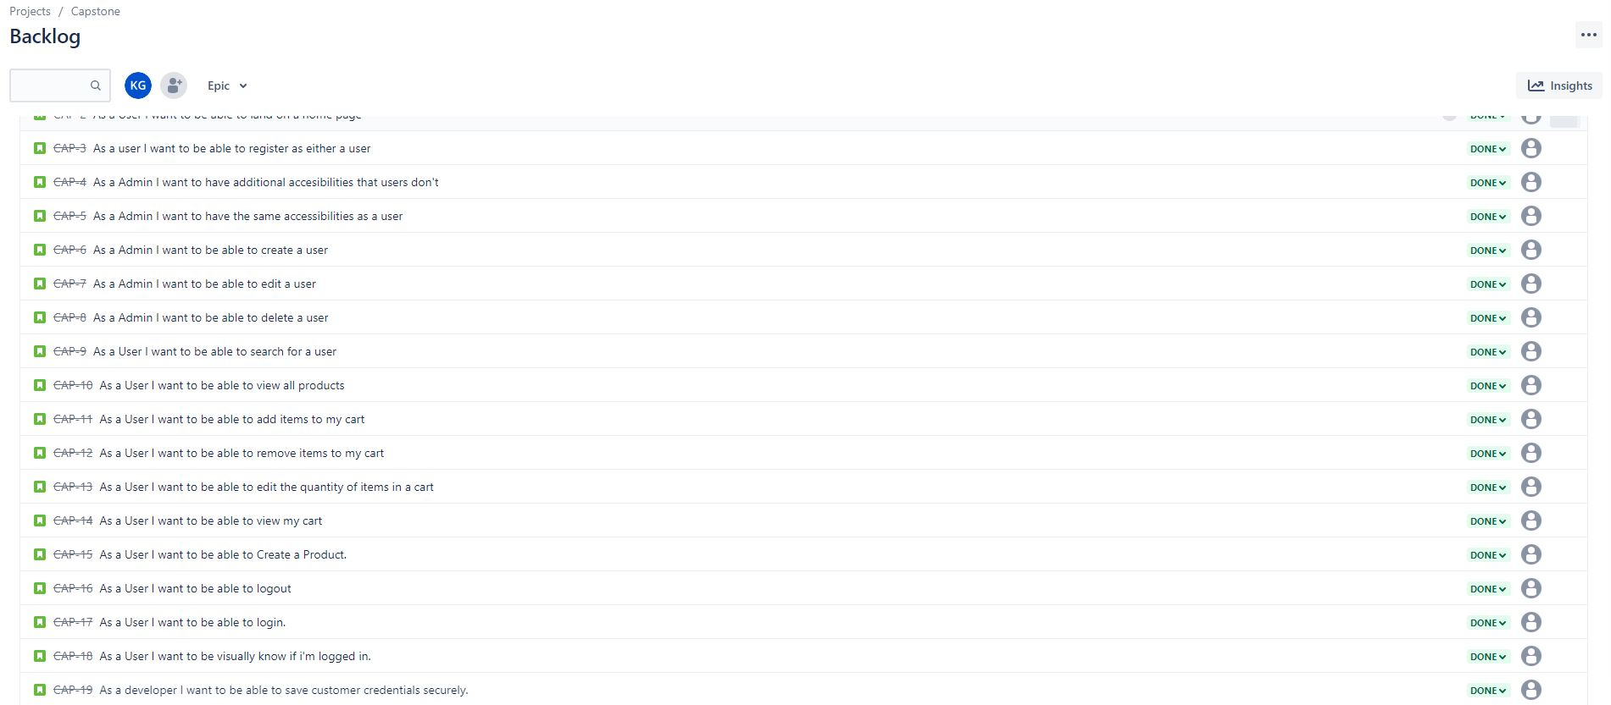
User Stories
To assist in overall development and make project more methodical.
Helped keep progress consistent and priorities straight.

Slide 7
Technical Challenges
Determining how to set up the relationship between entities
Determining how spring / spring security functions within the project
Random bugs/errors
Structure and relationship that JSP pages had within the project

Slide 8
Learning Achievements
Learn how to utilize online resources and ask for assistance when needed.
Learn how to form a linkage between front-end, back-end, and database.
Learning to debug and recognize errors with ease.
Learn to analyze other code, for better development of my code

Slide 9
Alternative Applications
Optum could refactor the code for nurses or other physicians to organize a list of medication and distribute intended medication to the respective patient via application.

Slide 10
Future Implementations
Create an additional link to navigate users to certain categories of products
Implement an account page where users can upload and update their information
Create a checkout system.

Slide 11


Q/A Session
Questions?

